Slide 1
Sequential Line Search for Efficient Visual Design Optimization by Crowds
SimpleLazyTeam
Yueh-Han Chuang Ke Han Yen-Hsiang Huang Han-Yu Lee Jiayi Wang

Slide 2
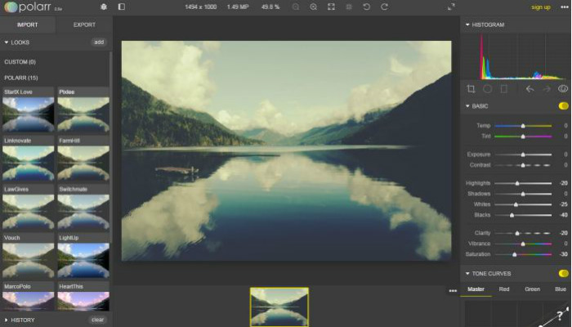
Introduction
Parameters tweaking
Common task in various design scenarios
Ex: color enhancement, 3D rendering, procedural modeling
Manually tweaking is difficult
Relationship between parameters and result is unknown
High-D space is not intuitively linked with low-level parameters
Tedious
Goal: Convert a complicated compound task into a sequence of simple tasks
Notes:
2’10”
Parameters tweaking requires expert skill -> we make it intuitive

Slide 3
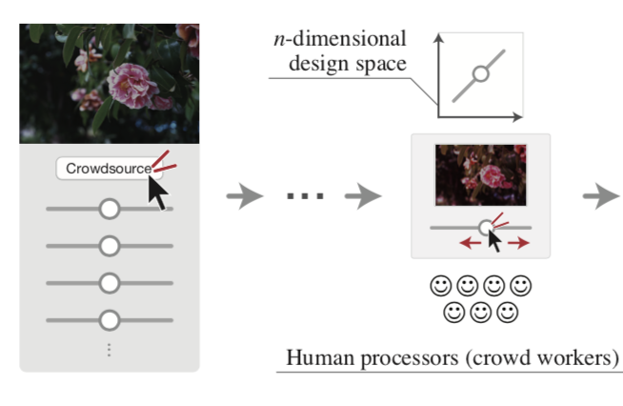
Literature
Show multiple candidates and let the user select the best one
Human-in-the-loop approach (Brochu)
Bayesian Optimization to select candidate images(Brochu)
Microtask-based crowdsourcing services(Quinn and Bederson)
Amazon Mechanical Turk
CrowdFlower
Microtask Design
Pairwise Comparison(Garces)
Gather n-point Likert-type scale data for a single stimulus(O’Donovan)
Notes:
A possible approach is to show multiple candidates and let the user select the best one
Bayesian optimization:high-dimension - > 1 dimension
Because human evaluation is considerably expensive compared to machine evaluation, Bayesian optimization can be a reasonable choice for human-in-the-loop settings(aesthetics)
Microtask Design for Crowdsourcing
Amazon Mechanical Turk and CrowdFlower: on-demand workforce, 24/7 -> mitigate -> use user’s value
Pairwise Comparison(2-forced alternative comparison) Simplify and show multiple candidates and let the user select the best on
4’16”
Explain in a sentence what each noun is, or maybe include an image?
We do not use amazon actually, that’s used by other people

Slide 4
Bayesian optimization based on line search oracle
Bayesian optimization
Find the maximum of a black-box (and expensive-to-evaluate) function
Notes:
7’56”
(hidden function: ex: the photo that user think is best, give analogy to our tasks)
Why is it not required to find mu?
One example is drilling an oil well, which cost millions to evaluate whether a place is profitable or not.
In our case, the black-box function is the aesthetic score of a photo in human’s mind.
Unlike drilling oil, we don’t have a quantitative way to evaluate that score

Slide 5
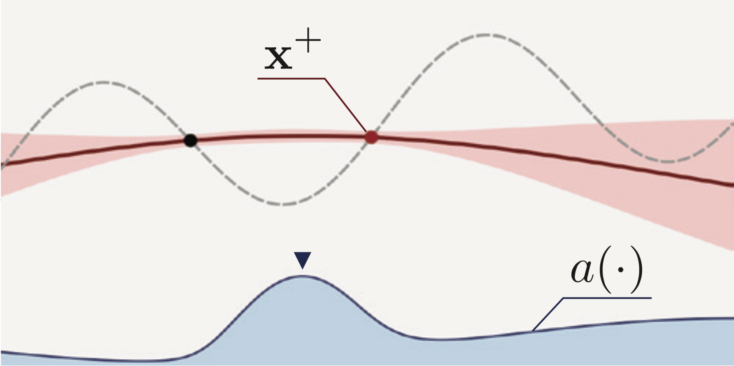
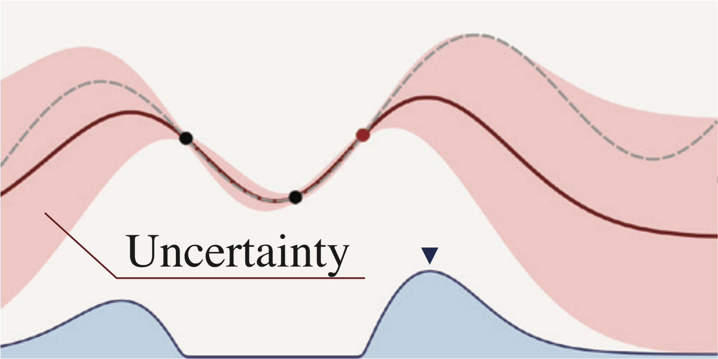
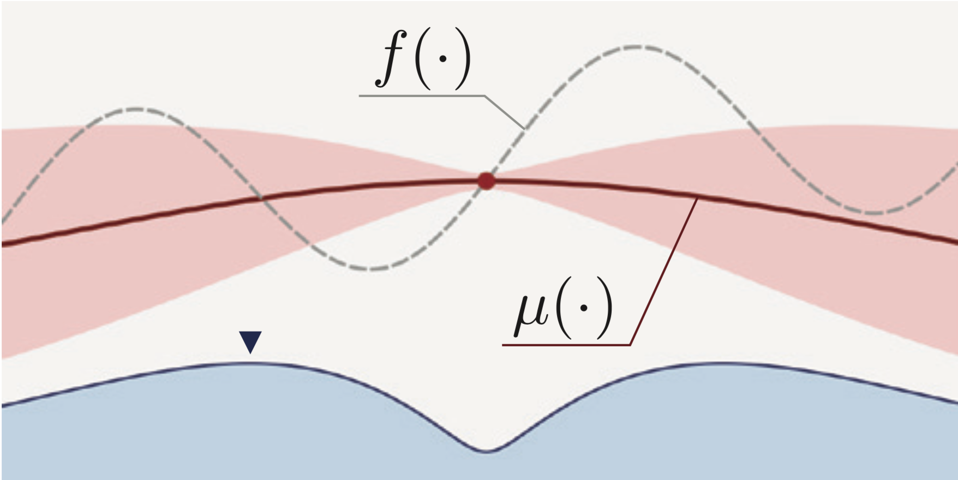
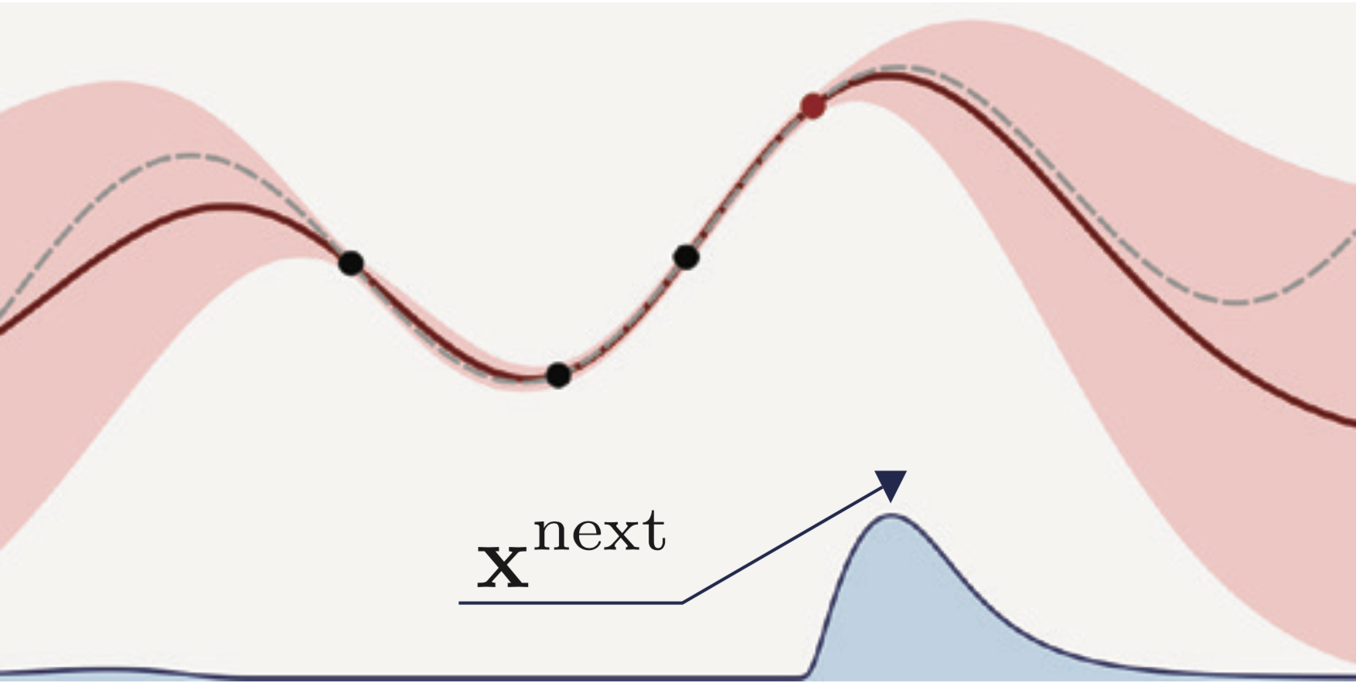

Slide 6
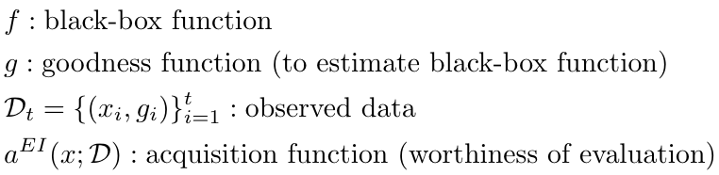
Bayesian optimization based on line search oracle
Bayesian optimization
Find the maximum of a black-box (and expensive-to-evaluate) function
Assume the black-box function ~ Gaussian Process
Human in loop
Evaluate the black-box function by querying line search to human.
Notes:
7’56”
(hidden function: ex: the photo that user think is best, give analogy to our tasks)
Why is it not required to find mu?
One example is drilling an oil well, which cost millions to evaluate whether a place is profitable or not.
In our case, the black-box function is the aesthetic score of a photo in human’s mind.
Unlike drilling oil, we don’t have a quantitative way to evaluate that score

Slide 7
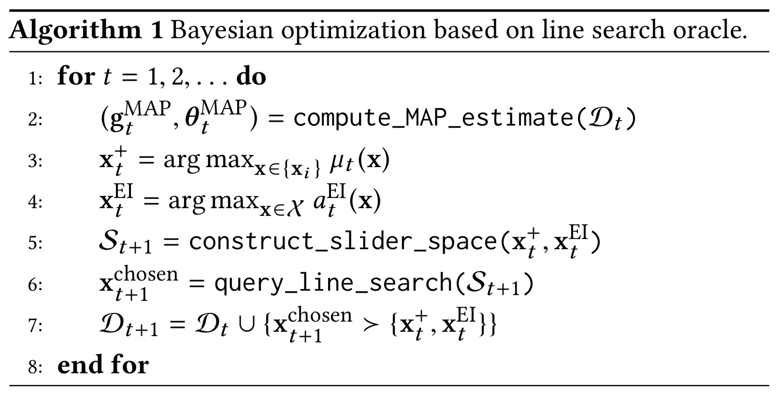
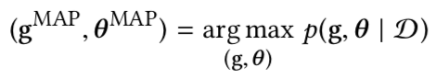
Method (algorithm)
Estimate parameters by observed data
Find current best point
Find a point with maximal expected improvement
Construct search bar
Let a human to pick up a point (maximum on this bar)
Add this point to observed data
Notes:
8’44”
List a(·) u(·) f(·) 上一頁der圖 參數跟output photo有什麼關係
Construct search bar
Let human pick up a point (maximum on this bar)
Add this point to observed dat

Slide 8
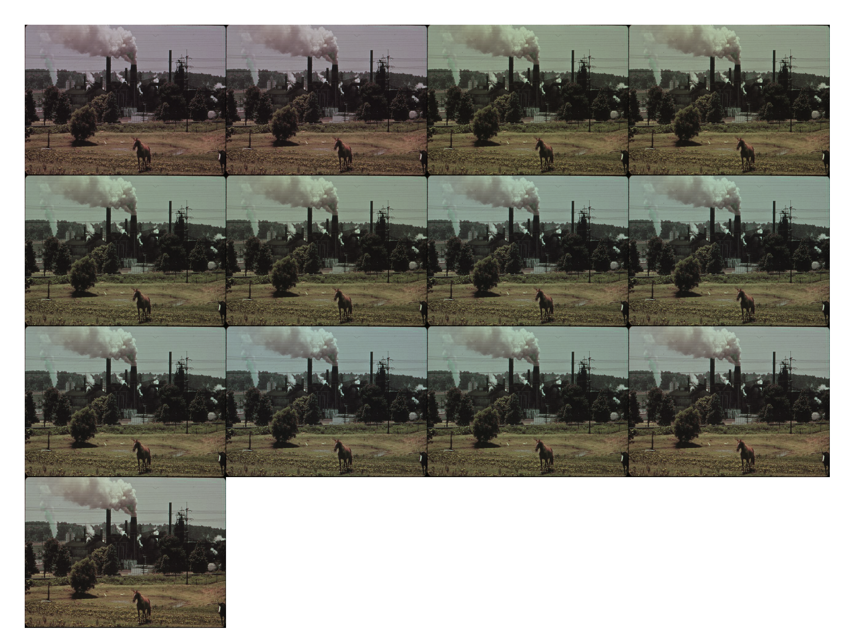
Demo

Slide 9
Discussion
Pros:
Friendly to everyone - Don’t even need to know a thing.
Straightforward - Easy to see changes and recover.
Soft modification - No change on original photo.
Cons:
Support limited file format and limited photo size only - PNG & 480 x 360 pixels.
Support 6 tuning parameters only - Brightness, Contrast, Saturation, R/G/B Balance.
Efficiency issue - May need do it over and over again till satisfied.

Slide 10
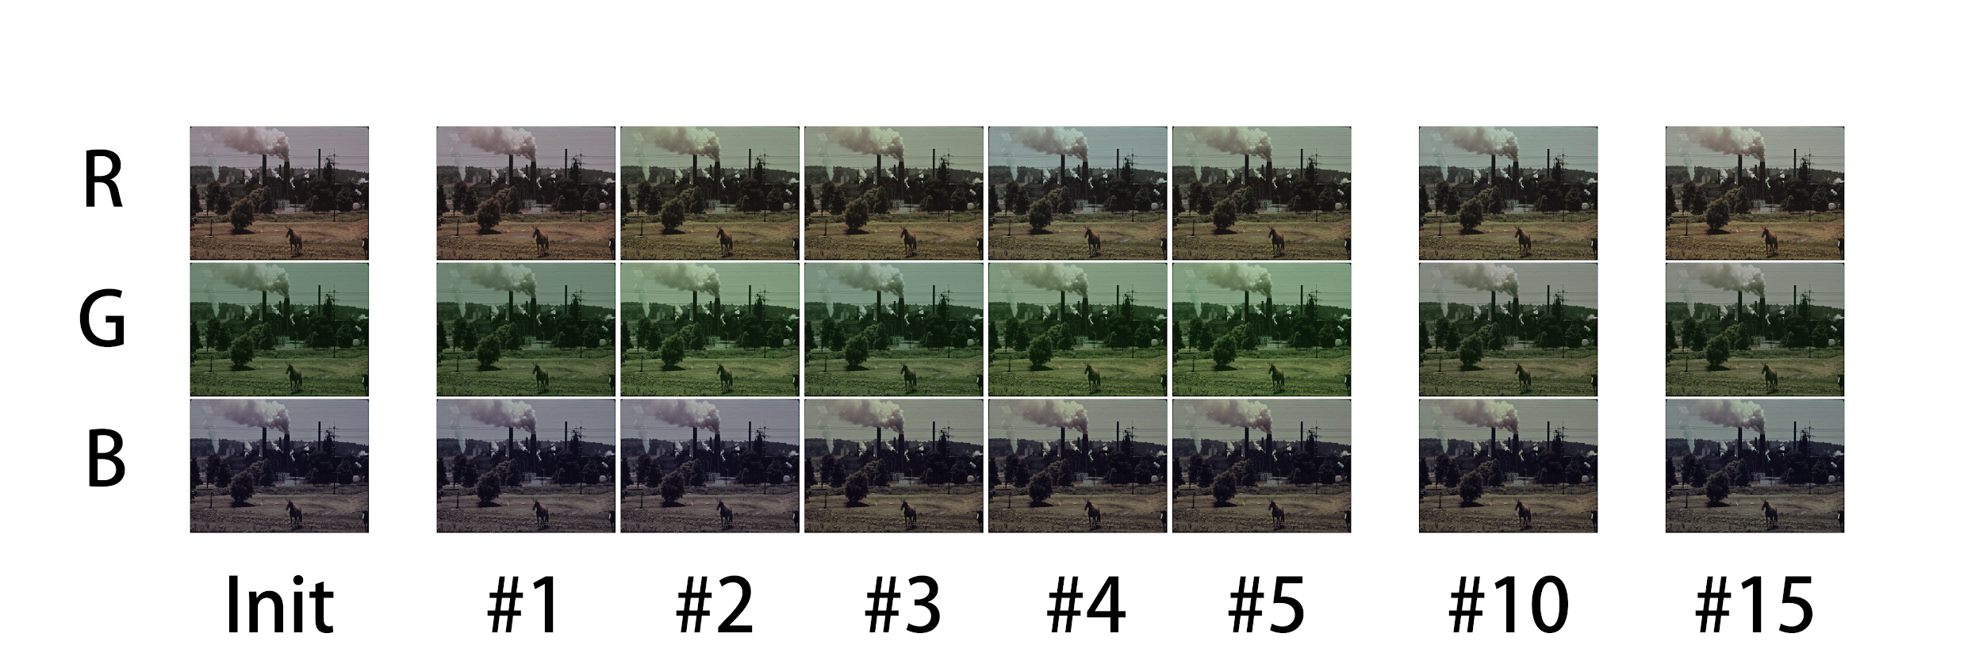
Conclusion
Successfully implemented the main part of the paper.
Involved human in the loop and found best image tweaking parameters.
Generated a final image which satisfy human preference.
Notes:
10’39”

Slide 11
Thank you
Q & A

